Slide 1
INTRUSION DETECTION: LEVERAGING
DATA ANALYTICS
AND MACHINE LEARNING
st124974
st125001

Slide 2
Problem Statement
What is Intrusion Detection?
A security process that monitors network or system activities for malicious actions or policy violations.
Why is Predicting Churn Important?
Identifies unauthorized access, data breaches, or potential threats in real-time.
Key to maintaining confidentiality, integrity, and availability of systems.
Objective of the Project:
Develop an efficient intrusion detection system using data analytics and machine learning.
Detect and classify malicious activities in real world with high accuracy.

Slide 3
Proposed Solution
Machine Learning Approach
We used supervised machine learning models such as XGBoost and LightGBM to detect intrusions
Why these models?
Both algorithms deliver excellent predictive accuracy and are optimized for speed and efficiency.
They handle large-scale datasets and high-dimensional features effectively.
Fast training due to parallel and distributed computing.
Work well with datasets having imbalanced classes, common in intrusion detection.
LightGBM: Optimized for large datasets with lower memory usage and faster computation.
XGBoost: Well-suited for handling complex relationships in data with high interpretability.

Slide 4
Data Sources and Quality
CIC-IDS2017
results of the network traffic analysis with labeled flows based on
time stamp
source
destination IPs
source and destination ports
protocols and attack
https://www.unb.ca/cic/datasets/ids-2017.html
CSE-CIC-IDS2018
includes precise details about operating system the attacker using
last updated attacks and protocols
https://www.unb.ca/cic/datasets/ids-2018.html
CIC-IDS-Collection
Combination of
CIC-IDS2017
CIC-DoS2017
CSE-CIC-IDS2018
CIC-DDoS2019

Slide 5

Methodology
Exploratory Data Analysis (EDA)
We will perform EDA to identity patterns in data, dropping duplicates, removing irrelevant values.
Modelling
Models: XGBoost, LightGBM
Evaluation metrics: Macro F1 Score Confusion Matrix, ROC-AUC
Handling Imbalanced Data
Implement strategies such as RandomUnderSampling
Cross Validation and Grid Search
stratified k-fold cross-validation to find the best model
Grid Search CV for finding the best hyperparameters for the best model

Slide 6
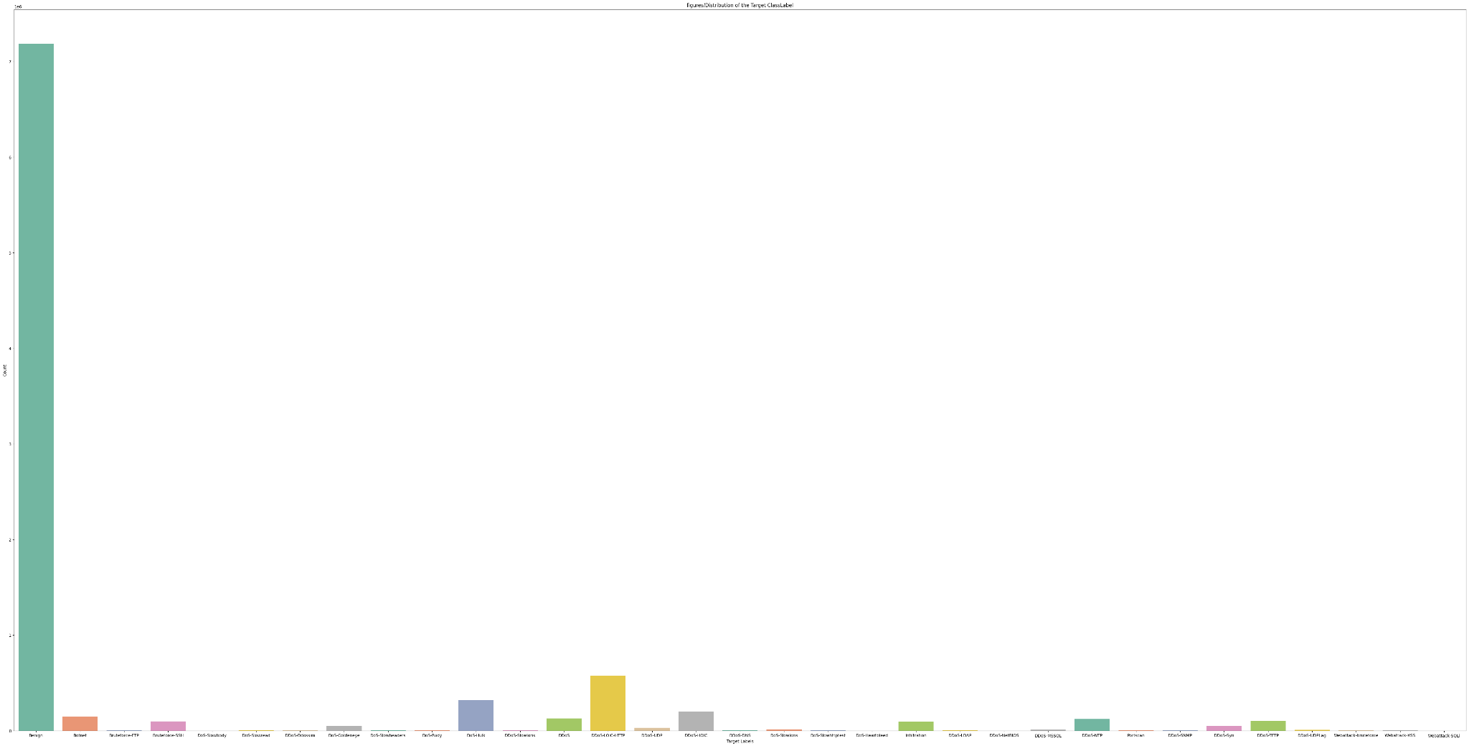
EDA

Slide 7
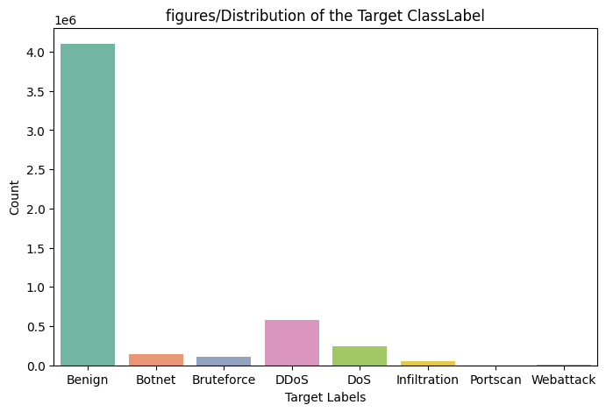
EDA

Slide 8
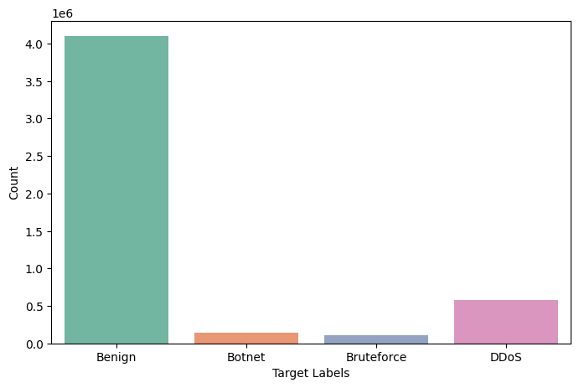
EDA

Slide 9
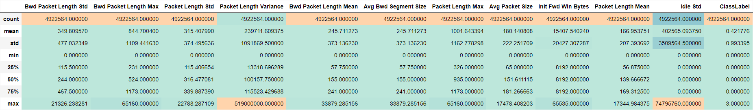
EDA

Slide 10
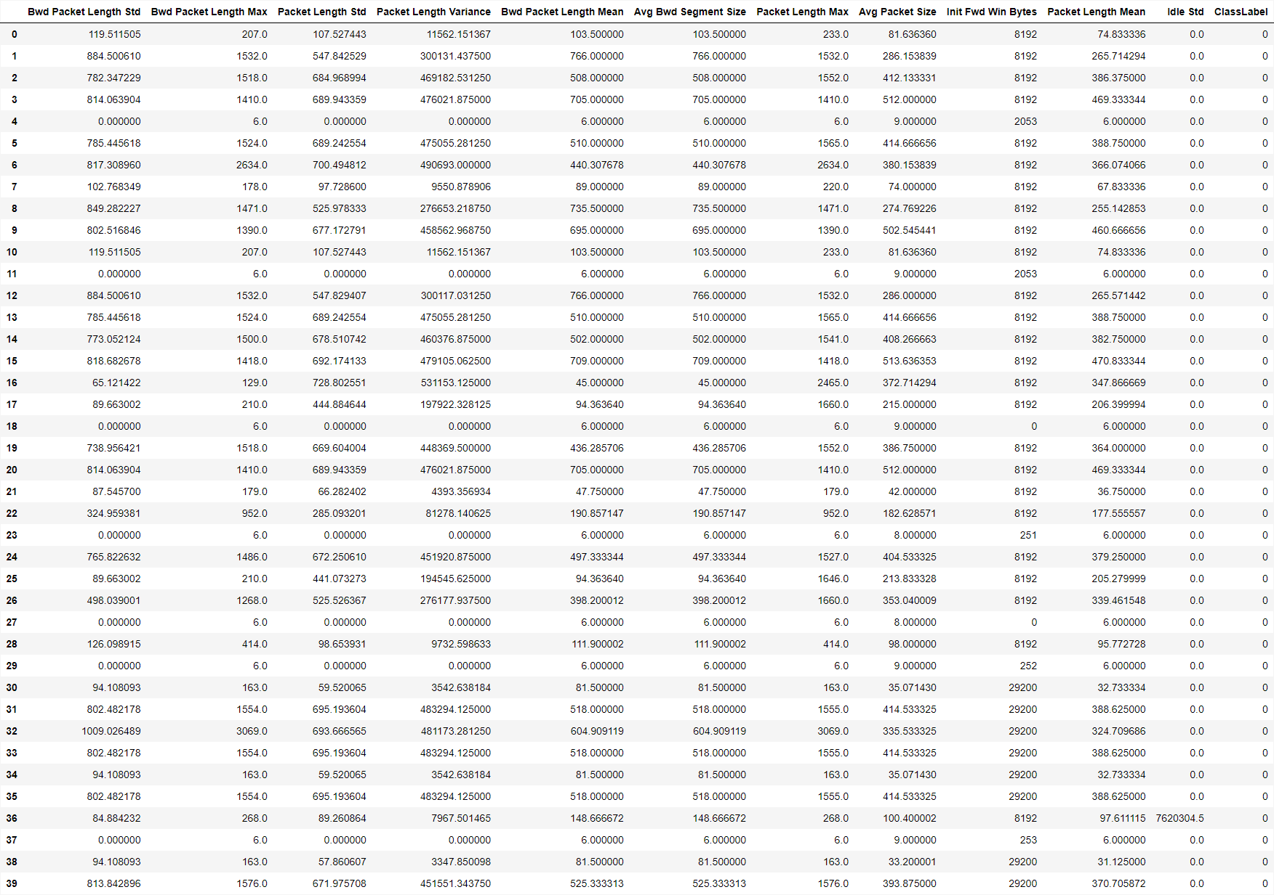
EDA

Slide 11
PIPELINE
allocated_cpus = os.cpu_count() // 2
scaling_transformer = SciPipeline(
steps=[("scaler", MinMaxScaler(feature_range=(0, 1)))]
)
preprocessor = ColumnTransformer(
transformers=[
("scaling_transformer", scaling_transformer, numerical_cols),
],
remainder="passthrough",
)
pipeline = ImbPipeline(
[
("preprocessor", preprocessor),
("under", RandomUnderSampler(random_state=69, sampling_strategy="majority")),
("classifier", GaussianNB()),
]
)

Slide 12
PIPELINE
param_grid = [
{
"classifier": [
LGBMClassifier(
n_jobs=allocated_cpus,
)
],
"classifier__num_leaves": [25, 50],
"classifier__n_estimators": [25, 50],
"classifier__learning_rate": [0.1, 0.01],
},
{
"classifier": [XGBClassifier(n_jobs=allocated_cpus)],
"classifier__max_depth": [3, 6],
"classifier__n_estimators": [25, 50],
"classifier__learning_rate": [0.1, 0.01],
},
{"classifier": [GaussianNB()]},
]

Slide 13
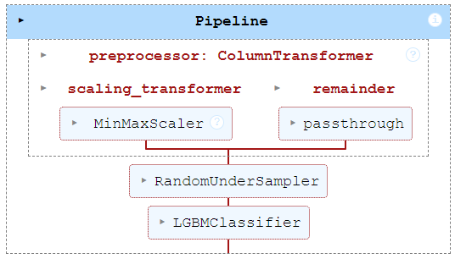
PIPELINE
from sklearn.model_selection import GridSearchCV, StratifiedKFold
kf = StratifiedKFold(n_splits=3, random_state=69, shuffle=True)
grid_search = GridSearchCV(pipeline, param_grid, cv=kf, scoring='f1_macro', n_jobs=os.cpu_count()//2, verbose=3)
grid_search.fit(X_train, y_train)
print("Best parameters found: ", grid_search.best_params_)
grid_search.best_estimator_

Slide 14
Evaluation Results
{
"0": {
"precision": 0.9998533120907509,
"recall": 0.9976954646842567,
"f1-score": 0.9987732228826901,
"support": 1229749.0
},
"1": {
"precision": 0.9765812197658122,
"recall": 0.9989363669996301,
"f1-score": 0.9876323068833871,
"support": 43248.0
},
"2": {
"precision": 0.9734244257106146,
"recall": 0.9995816438179829,
"f1-score": 0.986329644507248,
"support": 31074.0
},
"3": {
"precision": 0.9943928357383246,
"recall": 0.9991661793061917,
"f1-score": 0.9967737929162082,
"support": 172699.0
},
}

Slide 15
Evaluation Results
{
"0": {
"precision": 0.9998533120907509,
"recall": 0.9976954646842567,
"f1-score": 0.9987732228826901,
"support": 1229749.0
},
"1": {
"precision": 0.9765812197658122,
"recall": 0.9989363669996301,
"f1-score": 0.9876323068833871,
"support": 43248.0
},
"2": {
"precision": 0.9734244257106146,
"recall": 0.9995816438179829,
"f1-score": 0.986329644507248,
"support": 31074.0
},
"3": {
"precision": 0.9943928357383246,
"recall": 0.9991661793061917,
"f1-score": 0.9967737929162082,
"support": 172699.0
},
}

Slide 16
Evaluation Results
{
"macro avg": {
"precision": 0.9860629483263755,
"recall": 0.9988449137020154,
"f1-score": 0.9923772417973833,
"support": 1476770.0
},
"weighted avg": {
"precision": 0.9979770947584427,
"recall": 0.9979434847674317,
"f1-score": 0.9979512982462485,
"support": 1476770.0
}
}

Slide 17
Discussion
Performance Comparison
Higher Detection Rates: Superior accuracy, precision, recall, and F1-score compared to rule-based systems, especially for novel attacks.
Adaptability: Effective in detecting zero-day attacks, reducing false negatives.
Benchmarking: Competitive against other ML models; better handling of imbalanced data with XGBoost and LightGBM.
Limitations: Deep learning IDS models may outperform but require higher computational resources.
Performance Comparison
Higher Detection Rates: Superior accuracy, precision, recall, and F1-score compared to rule-based systems, especially for novel attacks.
Adaptability: Effective in detecting zero-day attacks, reducing false negatives.
Benchmarking: Competitive against other ML models; better handling of imbalanced data with XGBoost and LightGBM.
Limitations: Deep learning IDS models may outperform but require higher computational resources.

Slide 18
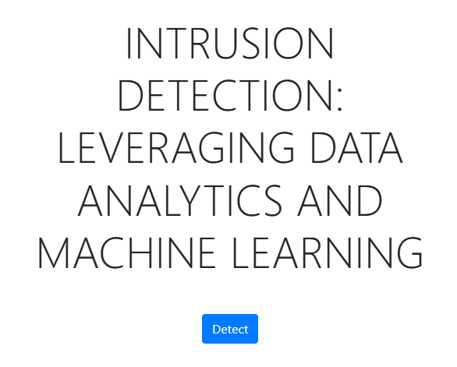
Deployment
https://archx64.me

Slide 19
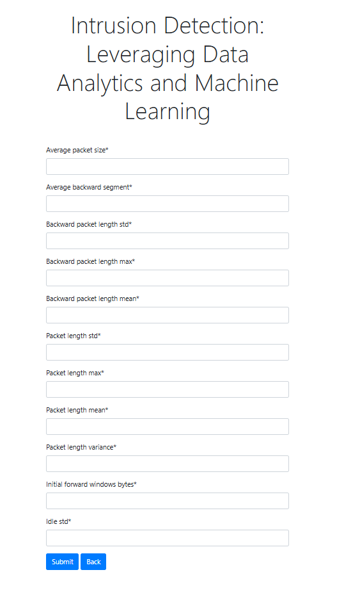
Deployment

Slide 20
Discussion
Performance Comparison
Higher Detection Rates: Superior accuracy, precision, recall, and F1-score compared to rule-based systems, especially for novel attacks.
Adaptability: Effective in detecting zero-day attacks, reducing false negatives.
Benchmarking: Competitive against other ML models; better handling of imbalanced data with XGBoost and LightGBM.
Limitations: Deep learning IDS models may outperform but require higher computational resources.
Interpretability vs Complexity
Tree-Based Models: Random Forest and decision trees offer higher interpretability.
Ensemble Methods: XGBoost and LightGBM are complex but powerful.
SHAP Insights: Explains feature importance and decision-making for complex models.
Advanced Algorithms: High resource demands, justified by better performance and accuracy.
Simpler Models: Faster training but less effective in capturing complex data patterns.

Slide 21
Conclusion
Balanced Approach: Combines performance, interpretability, and manageable complexity.
Model Selection: Depends on deployment needs trade-off between accuracy, interpretability, and computational resources.

Slide 22
Future Work
Further exploration of advanced models for improved detection.
Real time intrusion detection
Integration with existing security protocols for enhanced protection.

Slide 23

Any Questions?

